Slide 1
An Introduction to
Python For Data Science
November, 2017

Slide 2
What Is Python?
Python is:
A High Level
General Purpose Language
Object Oriented (with full support for other paradigms)
Interpreted
Created in the early 1990’s
Python 3.6 is the current version

Slide 3
1.Interpreter, modules and variables
Simple Hello World Program

Slide 4
1.Interpreter, modules and variables
Python Interpreter Vs Python modules
  Use Interpreter for testing or quick experiments
  .py files – modules that can be rerun, need a Python interpreter to be executed
Variables
  Get assigned values
  Can be reused, manipulated, reassigned … etc.
Printing
  Visual output of your code – is It working as it should be?

Slide 5
2.Variables and Operators (and comments)

Slide 6
2.Variables and Operators (and comments)
Variables
  No type declaration necessary (Python figures out the type)
  first assignment created the variable
  Assignment is done using “=“
Operations
  Carried out on variables (operands)
  Operator can behave differently based on the data type
    + Adds Integers, concatenates Strings
  Strongly-Typed is the way! (No implicit type conversions)
Comments Keep code clean and readable
  Whoever reads your code will thank you!
  # used to comment a single line

Slide 7
3.More on Variables

Slide 8
3.More on Variables
Multiple Assignment
  x,y=4,6
Basic Data Types:
  Integers (Default for Numbers) 5, 17 , 3000
  Floats :5.3, 7.324, -34.11, 5/2
  Strings: “Bob”, ‘John’, “Kevin’s”, “””Mark’s car is “black””””
Variable names are :
  Case Sensitive!
  Can NOT start with a number
  Can contain underscores, letters, numbers
  Can NOT be a reserved word (if, elif, global, return, pass, import …..etc.)

Slide 9
3.More on Variables (Continued)
Additional Notes:
Python binds variables to object references
  Assigning a variables created a reference to an object, NOT a copy of the object
A variable name does not imply the object type, the object referenced does
  X=7 , X=“Bob” is completely fine.
Some datatypes are mutable, some are immutable

Slide 10
4.Mutable Vs Immutable

Slide 11
4.Mutable Vs Immutable
REMEMBER:
Python binds variables to object references
Mutable:
content of objects of immutable types can be changed after they are created
More memory is assigned than needed
Support methods that change the object in place
Examples: list, set, dict
Immutable:
content of objects of immutable types cannot be changed after they are created
Hashable!
Examples: tuple, frozenset, float

Slide 12
5.More Data Types

Slide 13
5.More Data Types
Tuples
  A collection of “Elements”
  Can be sliced
    Elements Accessible individually using [n] or [-n]
    Ranges [1:2], [:2], [2:], [1:-1], [:]
  Elements cannot be changed (immutable)
  Check for element presence using “in” clause
Lists
  Like a Tuple, but with added functionalities
  Slower but more useful
  Elements can be inserted, appended, removed, deleted, “popped” and changed
Use len(x) to find length, x.index(n) on lists and tuples to “know your way”
A string is also a sequence type, closer to a tuple (immutable)!

Slide 14
5.More Data Types (Continued)
Sets (and Frozen Sets)
  An Unordered collection of “Unique” and “Immutable” objects
  Items Cannot be accessed using an index
  Sets are mutable while frozensets are immutable
Dictionaries
  Unordered Key Value Pairs
  Keys have to be immutable

Slide 15
5.More Data Types (Continued)
You can “Add” sequences:
  [1,2,3]+[4,5,6]
  (1,2,3)+(4,5,6)
  "Hello"+" "+"World! " (Look familiar?)
You can “Multiply” a sequence and an integer:
  [1,2,3]*3
  (1,2,3)*2
  "Hello"*3

Slide 16
6.Conditionals and loops

Slide 17
6.Conditionals and loops
Code blocks are identified using Indentation (no { } here!)
  Standard is 4 white spaces – tabs not recommended
Conditions can be evaluated using if, elif, else statements
= used for assignment, == used for comparison
!= is the opposite of ==
Loops allow you to execute a block of code several times using while or for..in
Else condition in loops are executed when condition is false
Stop a loop using break
Watch out for infinite loops!

Slide 18
7.Functions

Slide 19
7.Functions
Functions are defined using the keyword def
  def addition_function(x,y):
Values are returned using the return keyword (even if not present!)
  None value
Functions take arguments
A function can be an argument to another function
  addition_function(3,addition_function(3,5))
No types are defined for arguments or return types
Functions can call other functions
Objects have scopes

Slide 20
8.Scopes

Slide 21
8.Scopes
Objects have scopes
Be careful of what you are trying to reference
Use of return to make an object available

Slide 22
9.Modules

Slide 23
9.Modules
A module gains access to code in another module by importing it
Modules provide a way of code reuse
Python comes with a library of standard modules
  Such as the datetime module
  …or the statistics module
    Import statistics
    print(statistics.mean([1,2,3,4,5,6]))

Slide 24
Questions?

Slide 25
Resources
Official Python Docs
https://www.python.org/doc/
Free eBook : O’REILLY’s A WhirlWind Tour of Python
http://www.oreilly.com/programming/free/a-whirlwind-tour-of-python.csp
Python Beginners Guide Wiki
https://wiki.python.org/moin/BeginnersGuide/Programmers
Non-Programmer's Tutorial for Python 3
https://en.wikibooks.org/wiki/Non-Programmer%27s_Tutorial_for_Python_3

Slide 26
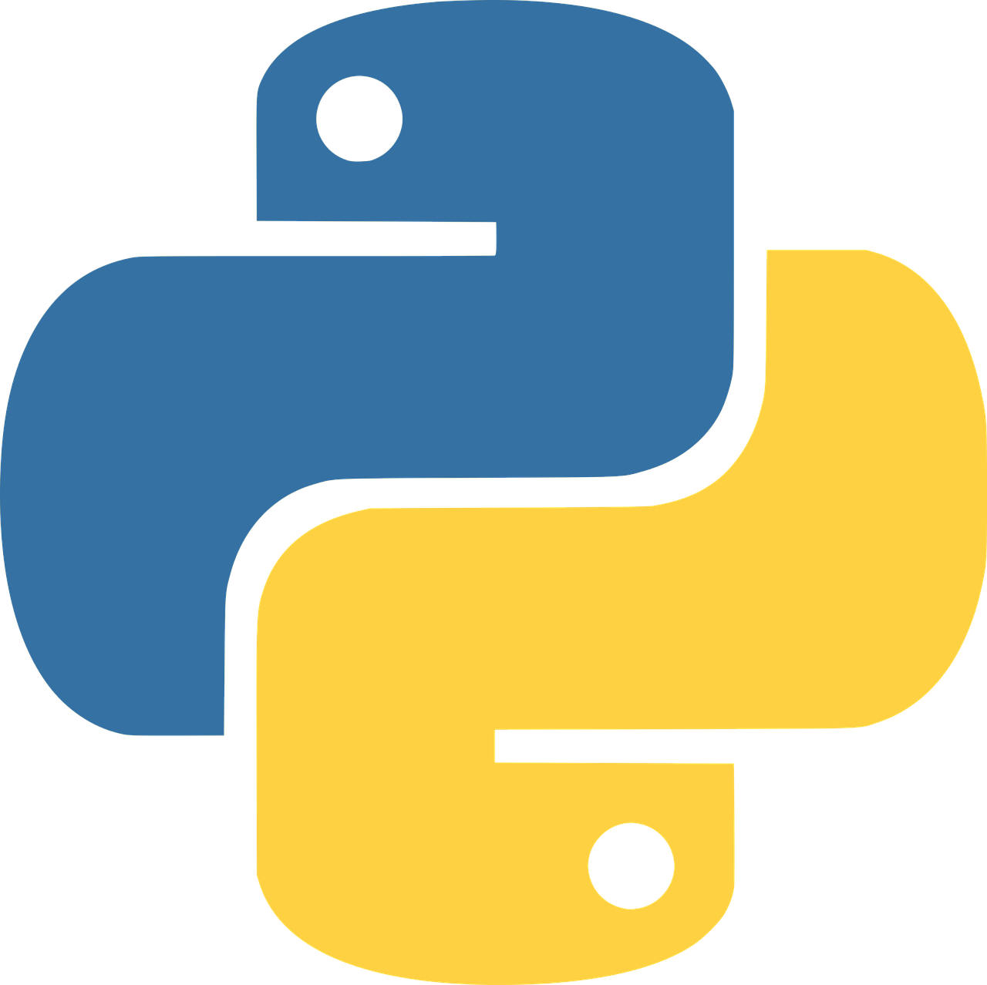
Thank You

